Slide 1
JavaScript Problems Project
By Justin Chong

Slide 2
Problem 1 – Word Break
“leetcode”
wordDict = [“leet”, “code”]
“applepenapple”
wordDict = [“apple”, “pen”]
wordDict = [“cats”, “dog”, “sand”, “and”, “cat”]
“catsandog”

Slide 3
“leetcode”
“leet code”, true
“applepenapple”
“apple pen apple”, true
“cats and og”, false
or “cat sand og”, false
“catsandog”

Slide 4
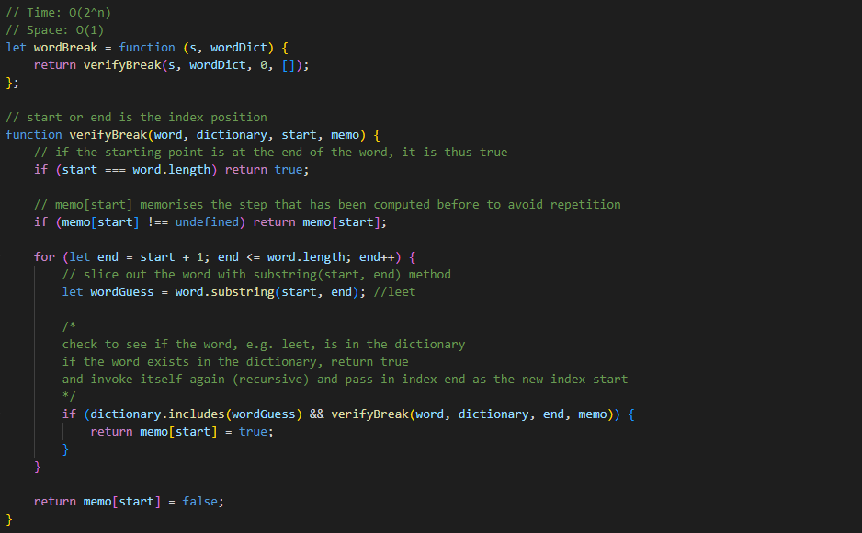

Slide 5
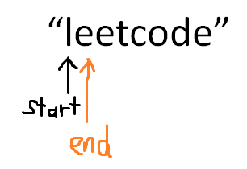
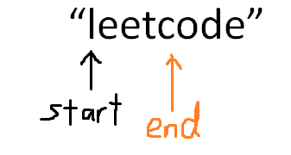
We’ll use the first example.
“leetcode”
word.substring(start, end)
We get “leet”.

Slide 6
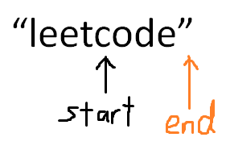
The new index start is from the previous index end.
word.substring(start, end)
We get “code”.
In the next recursion, start === word.length, so return true.

Slide 7
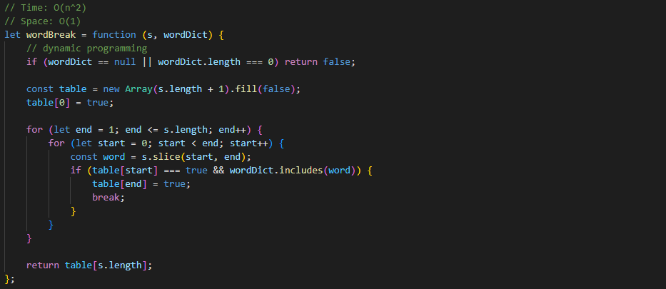

Slide 8
For the 2nd solution, we’ll use the first example once again.
“leetcode”
const table = new Array(s.length + 1).fill(false);
table = [
false, false, false, false, false, false, false, false, false
]

Slide 9
table[0] = true;
table = [
true, false, false, false, false, false, false, false, false
]
word.slice(start, end)
We get “leet”.

Slide 10
word.slice(start, end)
We get “leet”.
table[end] = true;
table = [
true, false, false, false, true, false, false, false, false
]

Slide 11
word.slice(start, end)
We get “code”.
table[end] = true; break;
table = [
true, false, false, false, true, false, false, false, true
]

Slide 12
Problem 2 – Group Anagrams
["eat", "tea", "tan", "ate", "nat", "bat"]
Output result:
[
[“eat”, “tea”, “ate”],
[“tan”, “nat”],
[“bat”]
]

Slide 13
Take the value of the first index for example: “eat”,
split it into “e”, “a”, “t”, then sort it into “a”, “e”, “t”, then join it into “aet”.
Use a hash and put the values that are in the same anagram group under the key.
Let hash = {}
Hash = {
“aet”: [“eat”]
}

Slide 14
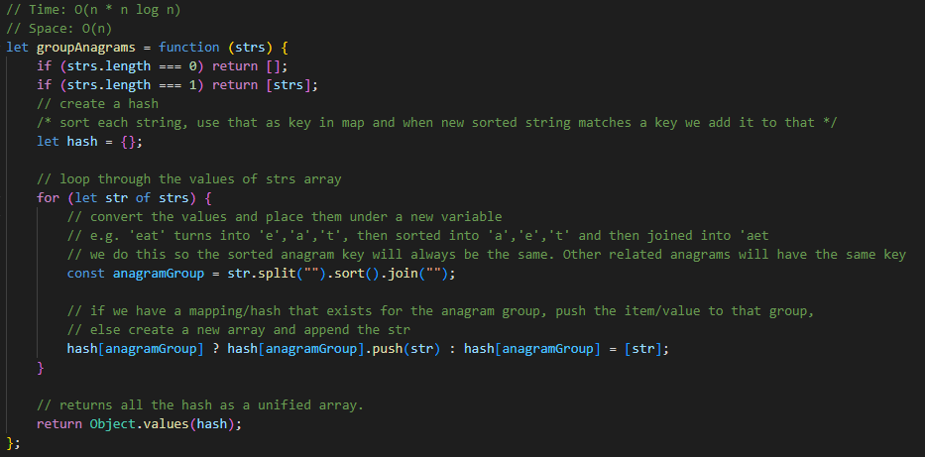

Slide 15
The hash should look like this in the end.
Hash = {
“aet”: [“eat”, “tea”, “ate”],
“ant”: [“tan”, “nat”],
“abt”: [“bat”]
}
Use the following to return all the values of the hash for Solution 1.
return Object.values(hash);
Output result: [
[“eat”, “tea”, “ate”],
[“tan”, “nat”],
[“bat”]
]

Slide 16
Similarly, we could use a Map and put the values that are in the same anagram group under the key.
Let hash = new Map([
[“aet”, [“eat”, “tea”, “ate”]],
[“ant”, [“tan”, “nat”]],
[“abt”, [“bat”]]
]);

Slide 17
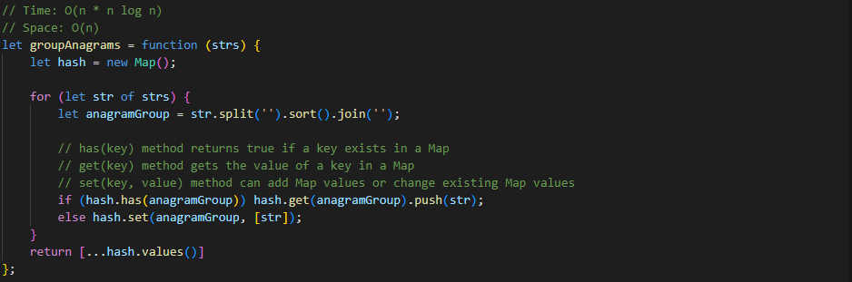

Slide 18
Use the following to return all the values of the hash for Solution 2.
Use the following to return the values in the Map.
return […hash.values()];
Output result: [
[“eat”, “tea”, “ate”],
[“tan”, “nat”],
[“bat”]
]

Slide 19
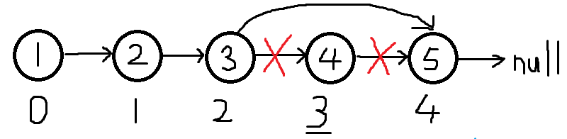
Problem 3 – Remove Nth Node From End Of List
n = 2, len = 5, len – n = removeIndex
Output result:

Slide 20
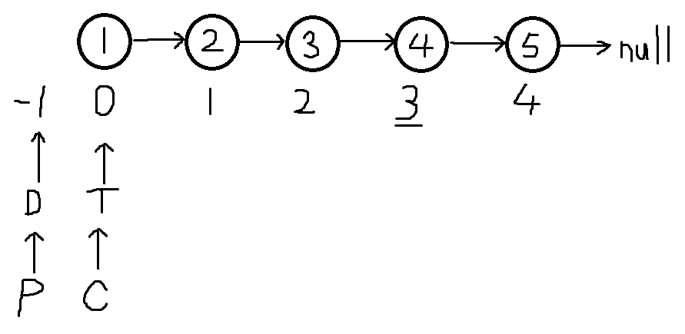
Let’s try illustrating it:
DummyHead (D) is on index -1 for reference.
Previous (P) will equals to dummyHead.
Tail (T) will equals to head, Current (C) will equals to head.

Slide 21
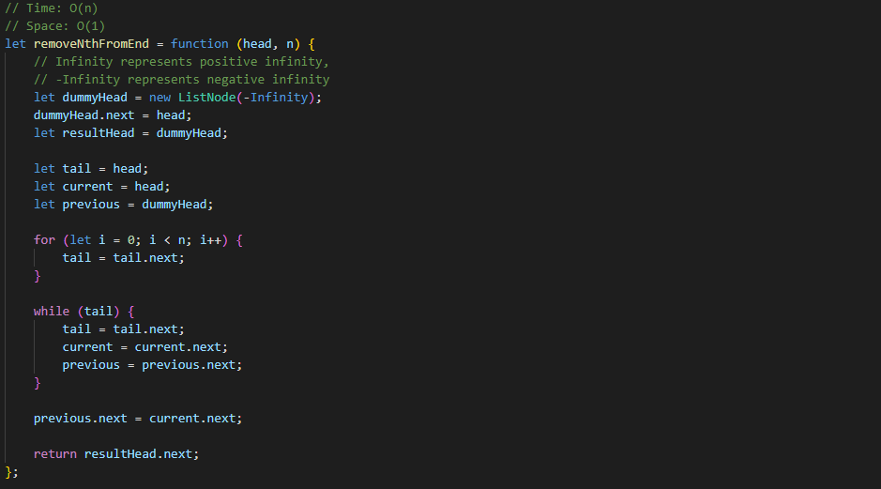

Slide 22
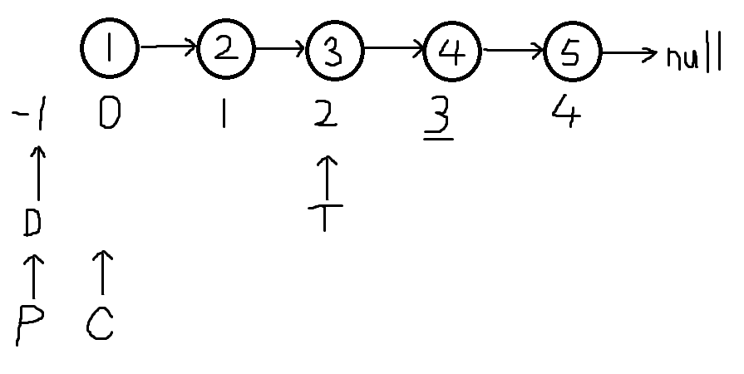
n = 2, so Tail (T) moves to index 3

Slide 23
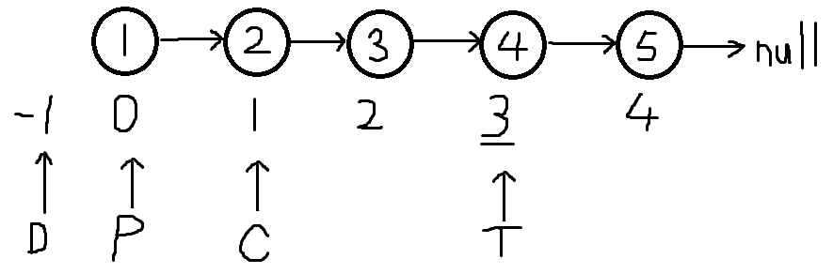
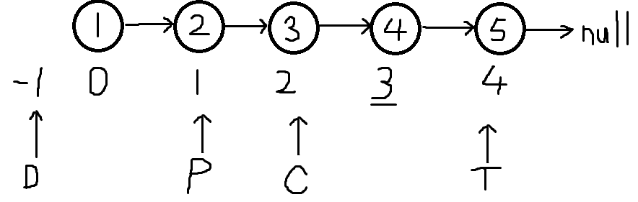
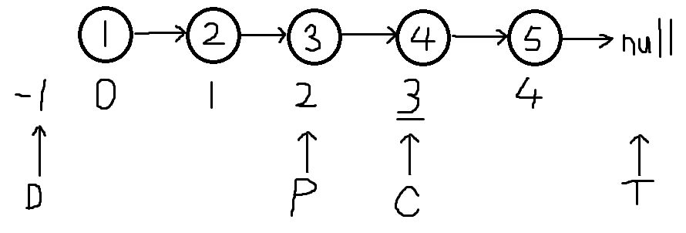
While Tail (T) is not null, keep looping until Tail (T) reaches null.
In the same loop, increment Current (C) and Previous (P) as well.
The dummyHead is a reference, dummyHead.next = head,
Let resultHead = dummyHead, we can use this to get a result later.

Slide 24
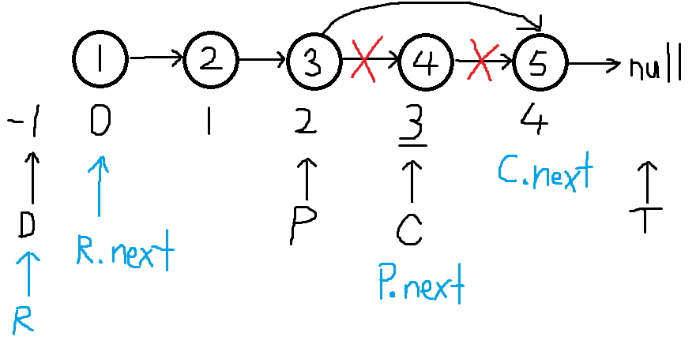
previous.next = current.next
return resultHead.next;

Slide 25
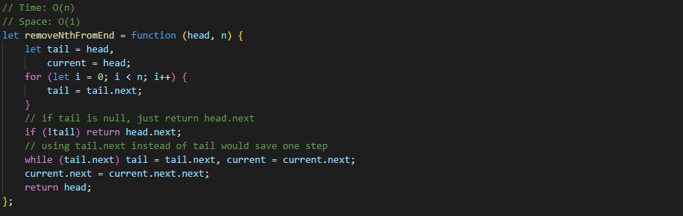

Slide 26
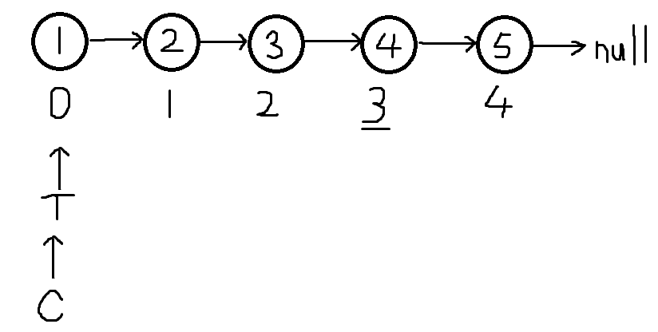
For the 2nd solution, it’s similar to the first solution, but with less variables and no dummy node. Here, we have Tail (T) = head, and Current (C) = head.

Slide 27
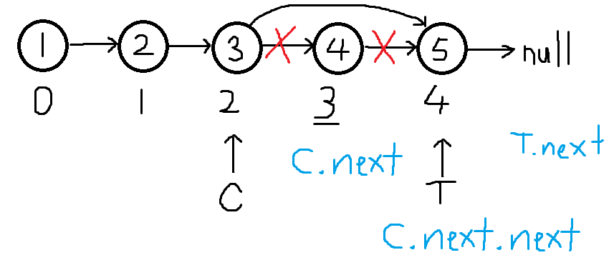
When we get to Tail.next equals to null,
Current.next = current.next.next;
return head,
We will get the new Linked List.

Slide 28
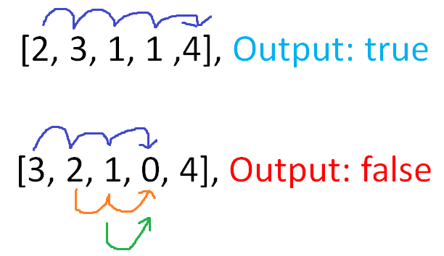
Problem 4 – Jump Game
The values in the array signify the number of steps you can take to jump from index position to the next.

Slide 29
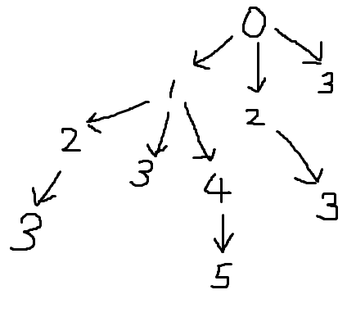
Take this example: [3, 3, 1, 0, 1, 2]
These are the possible routes where the numbers at the end signify the last possible index positions.

Slide 30
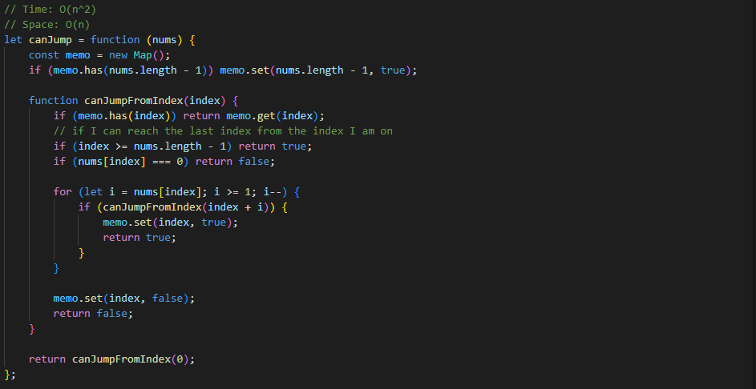

Slide 31
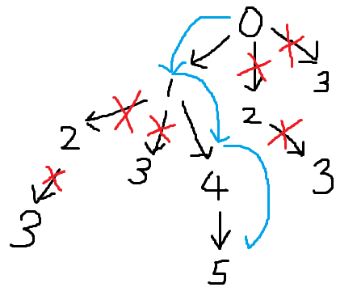
Let’s look at the best route:
i = nums[index], index + i
0 + 3 = 3 < nums.length - 1
1 + 3 = 4 < nums.length - 1
4 + 1 = 5 = nums.length - 1
From index 4, we can reach the last index in the array.
We can return true;
Reaching index 3 will get nums[index] = 0 and return false, no more steps left.

Slide 32
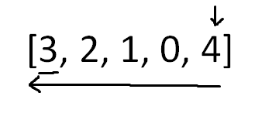
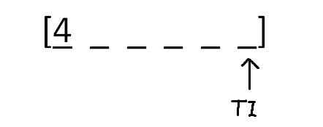
No steps is needed to jump to the last index if we are already on it.
Start with an example:
TI is Target Index

Slide 33
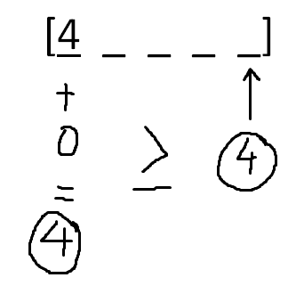
Value + Index,
see if it is equals to or
greater than TI.
In this case, it is.

Slide 34
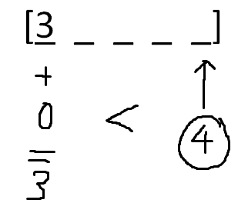
Let’s try again with 3 in the beginning instead.
In this case, Value + Index is less than Target Index, so that means it cannot get to Target Index from Index 0.

Slide 35
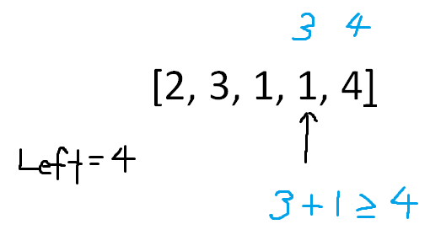

Let’s try again with the first example given.
[2, 3, 1, 1, 4]
Left most valid index will be represented by Left.
Our left most valid index is 4. Now we are on index 3.
3 + 1 is equals to or greater than 4, so we can get to index 4 from index 3. Now our left most valid index is updated to 3.

Slide 36
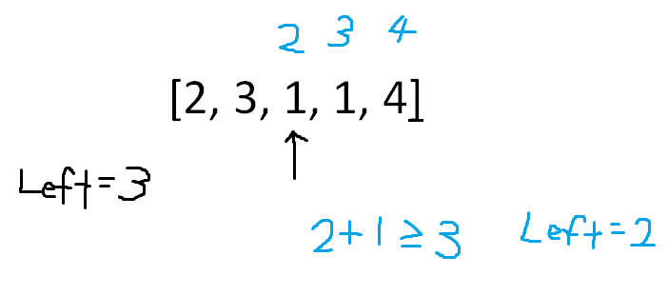
Now we are on index 2. Left = 3, can we get to index 3 from index 2.
2 + 1 is equals to or greater than 3, so we can get to index 3 from index 2. Now our left most valid index is 2.

Slide 37
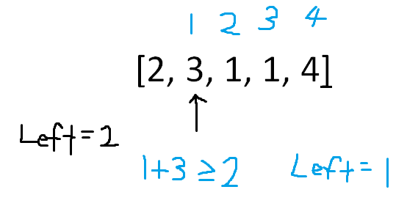
Now we are on index 1. Left = 2, can we get to index 2 from index 1.
1 + 3 is equals to or greater than 2, so we can get to index 2 from index 1. Now our left most valid index is 1.

Slide 38
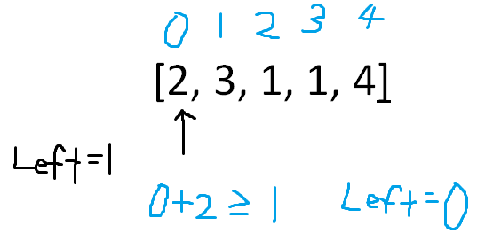
Now we are on index 0. Left = 1, can we get to index 1 from index 0.
0 + 1 is equals to or greater than 1, so we can get to index 1 from index 0. Now our left most valid index is 0.
Now we know we can get to the last index from the first index.

Slide 39
